Slide 1

Note: The data and information in this document is reflective of a hypothetical situation and client. This document is to be used for KPMG Virtual Internship purposes only.
Sprocket Central Pty Ltd
Data analytics approach
[OGUNJINMI ISAAC]

Slide 2
Note: The data and information in this document is reflective of a hypothetical situation and client. This document is to be used for KPMG Virtual Internship purposes only.
Agenda
Introduction
Data Exploration
Model Development
Interpretation

Slide 3
Note: The data and information in this document is reflective of a hypothetical situation and client. This document is to be used for KPMG Virtual Internship purposes only.
Introduction
ANALYSIS ON RECOMMENDING PROSPECTIVE CUSTOMER
The client has supply us with three dataset
We will use the dataset to make informative decision has to customer that are likely to add values and improve company’s income
The data is limited to 2017
APPROACH
Data cleaning
Feature Engineering/Selection
Data Exploration
Data Modelling

Slide 4
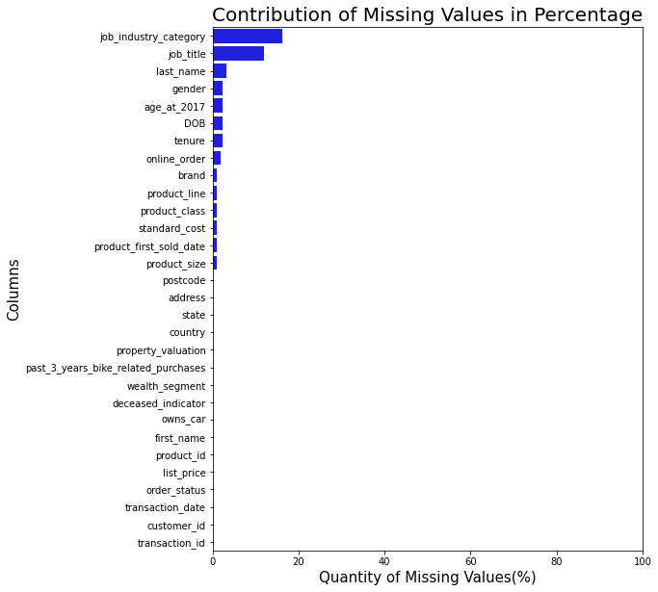
Note: The data and information in this document is reflective of a hypothetical situation and client. This document is to be used for KPMG Virtual Internship purposes only.
Data Exploration
MISSING VALUE
The column with highest missing value is job_industry_category with 16.16%
Hence missing values in all columns doesn’t not have a significant impact
Place any supporting images, graphs, data or extra text here.

Slide 5
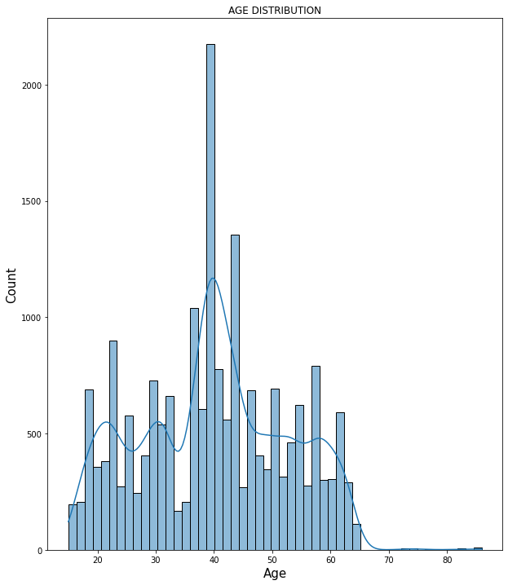
Note: The data and information in this document is reflective of a hypothetical situation and client. This document is to be used for KPMG Virtual Internship purposes only.
Data Exploration
AGE DISTRIBUTION
The distribution is tri-modal normal distributed curve with is clustered around 20, 30 and 40
STATISTICS
Statistics | Value
Mean | 39.9
Min | 15
Mode | 40
Max | 86

Slide 6
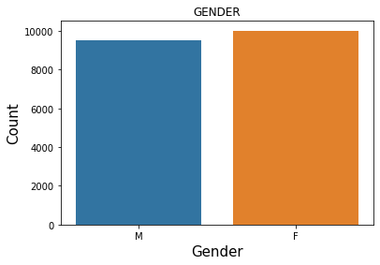
Note: The data and information in this document is reflective of a hypothetical situation and client. This document is to be used for KPMG Virtual Internship purposes only.
Data Exploration
GENDER EFFECT
Equal gender contribution
STATISTICS
Statistics | Value(%)
Female | 50.055
Male | 47.655

Slide 7
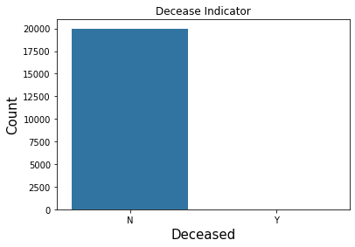
Note: The data and information in this document is reflective of a hypothetical situation and client. This document is to be used for KPMG Virtual Internship purposes only.
Data Exploration
Deceased Indicator
Relevant for future analysis and it can be relate to future event
STATISTICS
Statistics | Value(%)
Alive | 99.945
Dead | 0.040

Slide 8
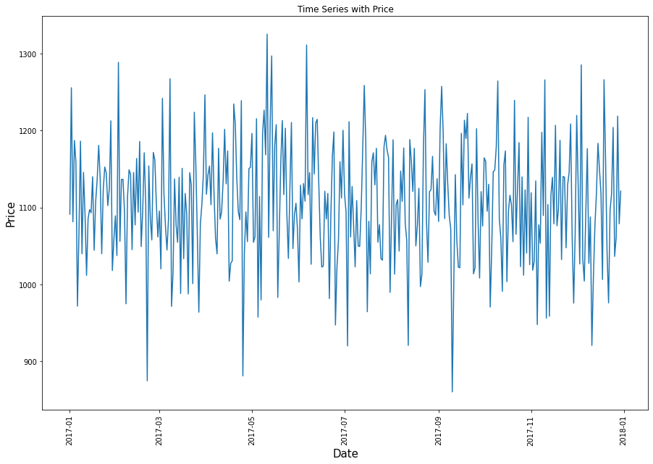
Note: The data and information in this document is reflective of a hypothetical situation and client. This document is to be used for KPMG Virtual Internship purposes only.
Data Exploration
TIME SERIES ANALYSIS

Slide 9
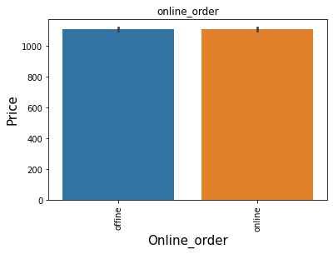
Note: The data and information in this document is reflective of a hypothetical situation and client. This document is to be used for KPMG Virtual Internship purposes only.
Model Development
EFFECT OF ONLINE ORDER
Both should be given priority
Place any supporting images, graphs, data or extra text here.

Slide 10
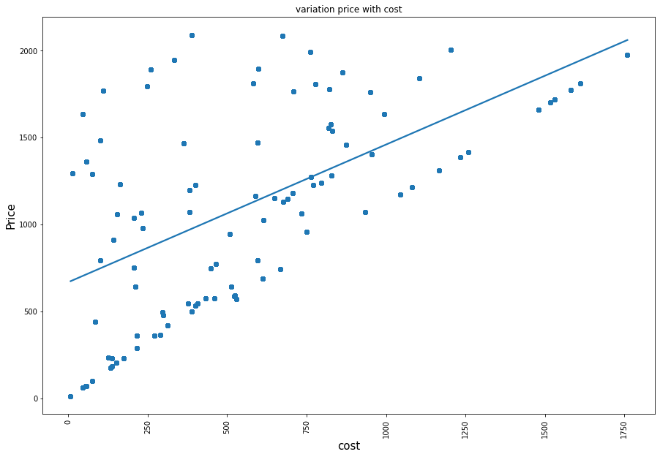
Note: The data and information in this document is reflective of a hypothetical situation and client. This document is to be used for KPMG Virtual Internship purposes only.
Model Development
PRICE AND COST
As the price is increase there is an increase in cost

Slide 11
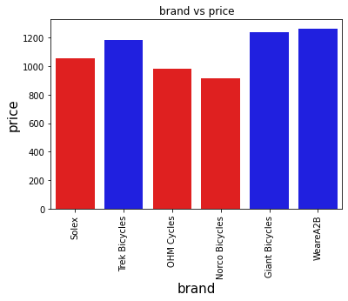
Note: The data and information in this document is reflective of a hypothetical situation and client. This document is to be used for KPMG Virtual Internship purposes only.
Model Development
Brand Popularity
Top popular brand include:
WeareA2B
Giant Bicycles
Trek Bicycles
Place any supporting images, graphs, data or extra text here.

Slide 12
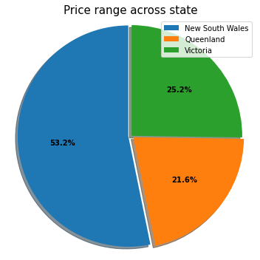
Note: The data and information in this document is reflective of a hypothetical situation and client. This document is to be used for KPMG Virtual Internship purposes only.
Model Development
SALES IN STATE
New South Wales has the highest Sales

Slide 13
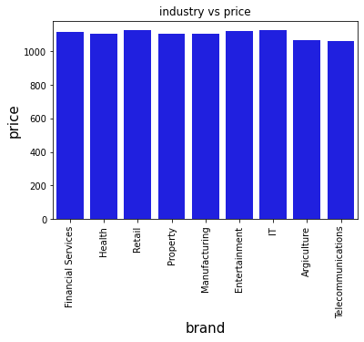
Note: The data and information in this document is reflective of a hypothetical situation and client. This document is to be used for KPMG Virtual Internship purposes only.
Model Development
Purchase Across Industry
IT and Entertainment leads the purchase with a few marge

